Slide 1
Progress in increasing access
to HIV treatment
in 5 SEE countries
December 15, 2020,
Zoia Zamikhovska, CO “100% LIFE”

Slide 2
Continuum of HIV care: Monitoring implementation
of the Dublin Declaration — 2018 progress report
https://www.ecdc.europa.eu/en/publications-data/continuum-hiv-care-monitoring-implementation-dublin-declaration-2018-progress

Slide 3
Dublin Declaration monitoring — 2016 progress
Reported mean cost of ART
per patient per year by country, 2014 and 2016 (in Euro)
https://www.ecdc.europa.eu/en/monitoring-implementation-dublin-2016

Slide 4
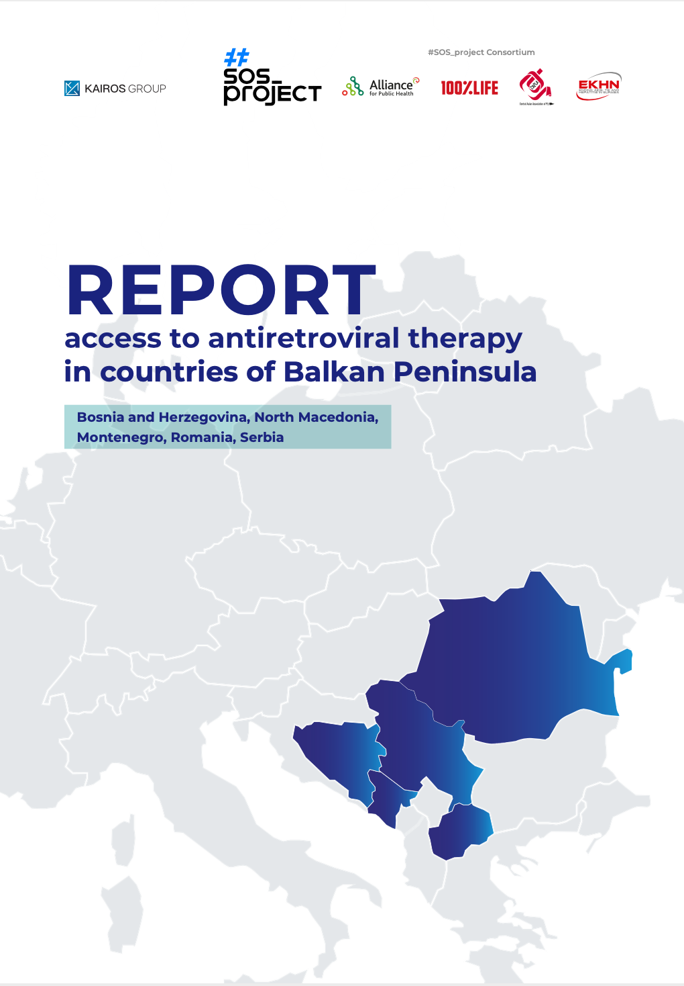
PURPOSE: to explore the potential to improve access to ARV treatment
5 SEE countries: BiH, Montenegro, N. Macedonia, Romania and Serbia
Desk review
Law firm focused on pharmaceutical regulations
Issues: process of registration, procurement system, reimbursement lists, prices, funding sources
Funded by the Global Fund to Fight AIDS, Tuberculosis and Malaria

Slide 5
ARV pricing in the 4 SEE countries
Prices per patient per year in euros
Comparison with upper-middle income Kazakhstan and low-middle Moldova
Medicine or combination | BiH (2019, PPPY EUR) | N. Macedonia (2020, PPPY EUR) | Montenegro (2017-2019, PPPY EUR) | Serbia (2019, PPPY EUR) | Kazakhstan (2020, PPPY, EUR) | Moldova (2019, PPPY, EUR)
TDF/FTC TAF/FTC | 850 - | 228 5964 | 684 – Year 2019 - | 2520 - | 45(g); 512(o) | 55
EFV600 | 6475 | 480 | 2496 – Year 2017 | 2292 | 30 | 40
TDF/FTC/EFV600 | - | 312 | - | - | 68 | 69
DTG | - | 5112 | - | 6468 | 1138 | 47
ABC/3TC | 3226 | 2196 | 3780 – Year 2017 | 2352 | 723 | 128
DTG/3TC/ABC | - | 5064 | - | 5640 | - | -
RAL | 7200 | 3648 | 6444 - 2017 | 5916 | 4114 | -
TDF/FTC/RPV | 8600 | 6852 | - | 4860 | 3202 | -

Slide 6
Core ARVs availability in the countries
INN | BiH | Serbia | N. Macedonia | Montenegro | Romania
TDF/FTC | Truvada, Gilead | Truvada, Gilead; 5 generics | 2 generics | Non-registered TDF not registered | 6 generics
DTG | Tivicay, GSK | Tivicay, GSK | Tivicay, GSK | Tivicay, GSK | Tivicay, GSK
EFV 600 | Stocrin, Merck | Stocrin, Merck; 1 generic | Non-registered | Stocrin, Merck | Stocrin, Merck
TDF/FTC/EFV600 | Non-registered | Non-registered | 1 generic | Non-registered | Atripla, Gilead; 4 generics
EFV 400 | Non-registered | Non-registered | Non-registered | Non-registered | Non-registered
ABC/3TC | Kivexa, GSK | Kivexa, GSK; 3 generics | 1 generic | Kivexa, GSK | Kivexa, GSK; 7 generics
ABC/3TC/DTG | Triumeq, GSK | Triumeq, GSK | Triumeq, GSK | Non-registered | Triumeq, GSK
TDF/FTC/RPV | Eviplera, Gilead | Eviplera, Gilead | Eviplera, Gilead | Non-registered | Odefsey, Gilead – with TAF
RAL | Isentress, Merck | Isentress, Merck | Non-registered | Isentress, Merck | Isentress, Merck
TAF/FTC/BIC | Non-registered | Non-registered | Non-registered | Non-registered | Bictarvy, Gilead
TAF | Non-registered | Vemlidy, Gilead | Non-registered | Non-registered | (TAF/FTC) Descovy, Gilead

Slide 7
Generic availability [State registry of medicines]
BiH TDF: PLIVA Hrvatska, Abdi Ibrahim, ILKO ILAC SANAYI | N. Macedonia TDF: Mylan, Emcure TDF/FTC: KRKA; Pliva Hrvatska TDF/FTC/EFV: KRKA ABC/3TC: Pliva Hrvatska DRV: KRKA
Serbia TDF: Mylan, Remedica, TEVA TDF/FTC: PLIVA Hrvatska, Remedica, KRKA, TEVA, Merckle EFV: Pharmadox ABC/3TC: Pliva Hrvatska, Remedica, Pharmadox ZDV: Slaviamed ZDV/3TC: Pharmadox DRV: KRKA | Romania Wide range of generics from Europe for TDF/FTC, TDF/FTC/EFV, ABC/3TC, ZDV/3TC, LPV/r, ATV, DRV, RTV Main generic companies: Mylan, Aurobindo, Cipla, TEVA, Sandoz, Zentiva, BRISTOL-MYERS, Accord, Terapia s.a.

Slide 8
Medicine registration
Long general procedure of registration — up to 210 days
Simplified registration for drugs is available, but for limited cases:
Only registered medicines can participate in a tender except for:
Serbia and Montenegro: for registered in EU, innovative; procedure shortened to <= 150 days
Romania: for registered in EU; procedure shortened to <= 90 days
N. Macedonia: for registered in EU, USA, Japan, Switzerland and Canada; procedure shortened to <= 15-90 days
BiH – not allowed
N. Macedonia —
priority to registered in case of competition
Serbia — List D of the Reimbursement list, only pediatric ARV forms

Slide 9
Procurement regulations and practices
Procurement list:
only ARVs from the Reimbursement Lists – BiH, Serbia, Montenegro, Romania
based on the needs formed by the Clinic of infectious diseases – N. Macedonia
Procurement systems:
centralized – Serbia, N. Macedonia, Montenegro
decentralized – Romania (health facilities)
decentralized and centralized – BiH (Solidarity funds + health facilities)
Laws do not foresee the use of international procurements of ARVs

Slide 10
Generic availability [Reimbursement List]
BiH – not included | N. Macedonia – not applicable
Serbia TDF: Myaln, Remedica TDF/FTC: Remedica, KRKA ABC/3TC - Pliva Hrvatska ZDV - Slaviamed | Romania TDF: Zentiva, Accord, TEVA, Aurobindo, Sandoz, Mylan, Alvogen, TDF/FTC: Mylan, Accord, TEVA, Alvogen 3TC – Aurobindo, TEVA ZDV/3TC: Accord, TEVA, Aurobindo LPV/r: Mylan, Accord ATV - BRISTOL-MYERS RTV – Mylan, Accord DRV - KRKA, Alvogen, Sandoz, Zentiva, Mylan, TEVA

Slide 11
Generic uptake
Montenegro: no generics registered or included in the Reimbursement List
BiH: only TDF generics are registered (3 positions), but no generics in the Reimbursement List
BiH (2019) and Montenegro (2017-2019): no generics procured
Serbia (2019):
 | TDF | TDF/FTC | EFV | ABC/3TC
Registry List | Mylan, Remedica, TEVA | PLIVA Hrvatska, Remedica, KRKA, TEVA, Merckle | Pharmadox | Pliva Hrvatska, Remedica, Pharmadox
Reimbursement List | Myaln, Remedica | Remedica, KRKA | - | Pliva Hrvatska
Procured | Remedica LTD – 161 EUR | Remedica LTD – PPPY 207 EUR | - | Pliva Hrvatska PPPY 190 EUR

Slide 12
Financing of HIV treatment programs
All financed from domestic funds:
National Health Insurance Fund — BiH, Serbia, Montenegro, Romania
Ministry of health — N. Macedonia, Romania
Local budget — Romania
International funding exception — Romania
In August 2019, EUR 161.9 million was expected to be reimbursed under the European Social Fund (ESF).

Slide 13
Most challenging areas
High prices for ARVs
Distributors role in keeping prices high?
Small markets and bids
Long process of state registration
Complicated procurement systems in Romania and BiH
Low competition
Prevalence of original medicines in the Reimbursement List in BiH

Slide 14
Progress/good practices
Centralized procurement system: Serbia, N. Macedonia, Montenegro
Opportunity to participate in a tender with unregistered drugs: N. Macedonia, Serbia
Nomenclature is formed from one insurance list: N. Macedonia, Serbia
Long term contracts for procurements (3 years): Romania
All countries have a national e-procurement system
Preferential VAT rate for ARVs (min.0%, max. 10%), all except for BiH (17%)
Possibility of importing drugs in foreign packaging, all except for Montenegro

Slide 15
Thank you!
CO “100% LIFE”
z.zamikhovska@network.org.ua
www.network.org.ua

Slide 16
Core ARVs availability in the countries [Additional slide]
INN | BiH | Serbia | N. Macedonia | Montenegro | Romania
TDF/FTC | Truvada, Gilead | Truvada, Gilead; KRKA, Teva; Pliva; Remedica; Merckle | KRKA; Pliva | Non-registered TDF not registered | Alvogen; Accord healthcare polska; Mylan; Sandoz; Teva; Cipla
DTG | Tivicay, GSK | Tivicay, GSK | Tivicay, GSK | Tivicay, GSK | Tivicay, GSK
EFV 600 | Stocrin, Merck | Stocrin, Merck; Pharmadox | Non-registered | Stocrin, Merck | Stocrin, Merck
TDF/FTC/EFV600 | Non-registered | Non-registered | KRKA | Non-registered | Atripla, Gilead; KRKA; Mylan; Zentiva; Sandoz
EFV 400 | Non-registered | Non-registered | Non-registered | Non-registered | Non-registered
ABC/3TC | Kivexa, GSK | Kivexa, GSK; Remedica; Pharmadox; Pliva | PLIVA | Kivexa, GSK | Kivexa, GSK; Aurobindo; Mylan; Sandoz; S.c. terapia; Teva; Zentiva; Alvogen
ABC/3TC/DTG | Triumeq, GSK | Triumeq, GSK | Triumeq, GSK | Non-registered | Triumeq, GSK
TDF/FTC/RPV | Eviplera, Gilead | Eviplera, Gilead | Eviplera, Gilead | Non-registered | Odefsey, Gilead – with TAF
RAL | Isentress, Merck | Isentress, Merck | Non-registered | Isentress, Merck | Isentress, Merck
TAF/FTC/BIC | Non-registered | Non-registered | Non-registered | Non-registered | Bictarvy, Gilead
TAF | Non-registered | Vemlidy, Gilead | Non-registered | Non-registered | TAF/FTC Descovy, Gilead

