Slide 1
ARV PRICING
IN BOSNIA AND HERZEGOVINA
SINIŠA SKOČIBUŠIĆ, MD, MSC
ID SPECIALIST
SINISA.SKOCIBUSIC@GMAIL.COM

Slide 2
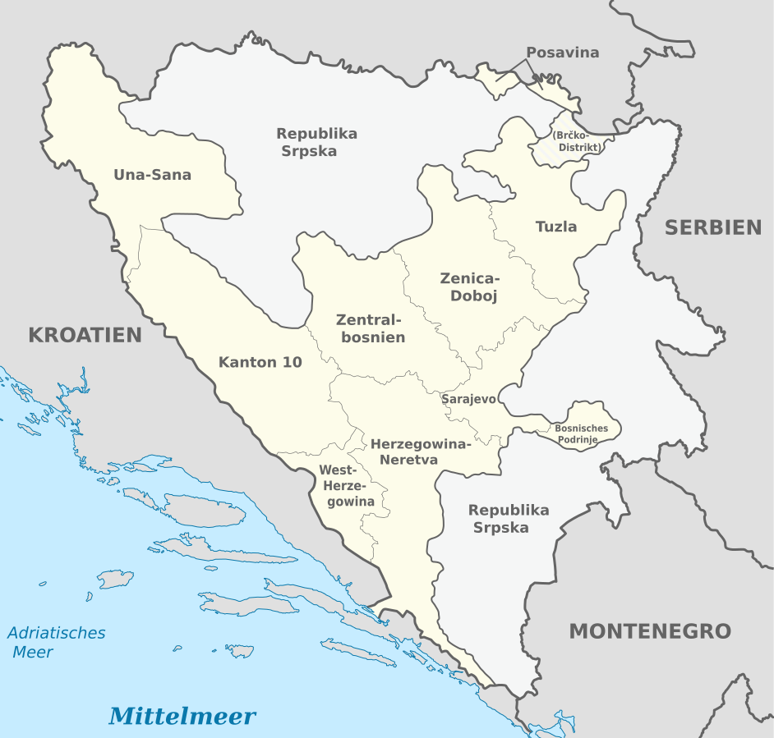
Bosnia and Herzegovina has:
Population of 3.5 million (2013)
Complex asymmetric, governing structure of the country.
ARVs are funded from 2 public health insurance funds:
Health Insurance and Reinsurance Institute of Federation of Bosnia and Herzegovina
Health Insurance Fund of Republic of Srpska

Slide 3
TREATMENT GUIDLINES AND PROCUREMENT
GUIDLINES:
HIV/AIDS treatment is regulated by the Clinical Guidelines for the Treatment of HIV and AIDS in Bosnia and Herzegovina (2013)
The 2016 guidelines have not been officially approved
A joint Task Force to Develop National Treatment Guidelines with delegated experts from both entities began operations in 2020
PROCURMENT:
Health Insurance and Reinsurance Institute of Federation of Bosnia and Herzegovina – decentralized by hospitals
Health Insurance Fund of Republic of Srpska - centralized

Slide 4
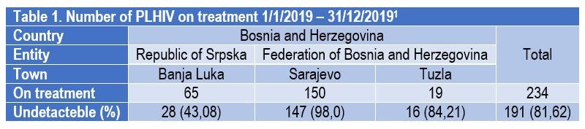
UN’s 90-90-90 treatment goals?
Bosnia and Herzegovina is a low-prevalence country, with a total of 234 PLHIV receiving the ARV treatment.
The goal of 90% of people receiving ARV treatment who have achieved the viral suppression has not been reached yet and varies by region.
¹ Data presented 29/10/2020 during Meeting of the Task Force to Develop National Treatment Guidelines on Vlašić, Bosnia and Herzegovina

Slide 5
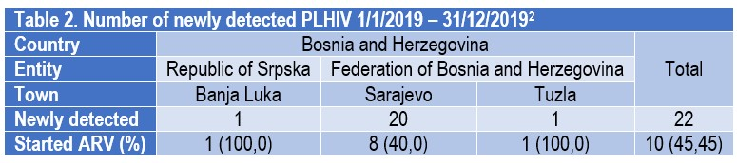
Number of newly identified PLHIV, compared to total number of PLHIV receiving treatment, is high 10,38% (22/212).
Limited number of newly identified PLHIV enrolled into the ARV treatment.
¹ Data presented 29/10/2020 during Meeting of the Task Force to Develop National Treatment Guidelines on Vlašić, Bosnia and Herzegovina

Slide 6
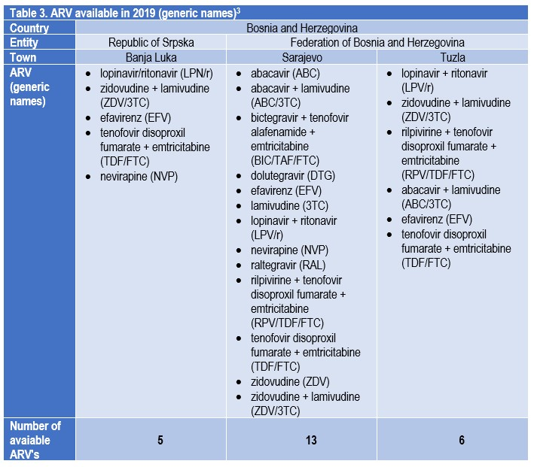
There is a disparity in availability of ARVs in different entities (Federation BiH and Republic of Srpska).
Furthermore, there is disparity amongst cities within the same entity.
This inconsistency creates discrimination based on place of residence and lowers the quality of treatment.
³ Data presented 29/10/2020 during Meeting of the Task Force to Develop National Treatment Guidelines on Vlašić, Bosnia and Herzegovina

Slide 7
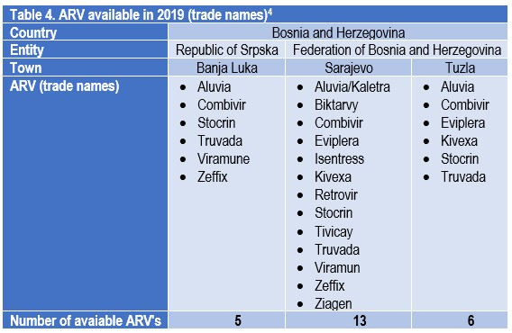
The originals dominate over generic medicines
ARV presentation:
7 Single Formulations
4 Dual Fixed Dose Combinations
2 Triple Fixed Dose Combinations
⁴ Data presented 29/10/2020 during Meeting of the Task Force to Develop National Treatment Guidelines on Vlašić, Bosnia and Herzegovina

Slide 8
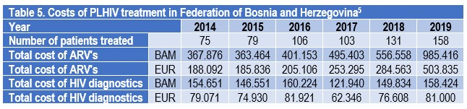
The cost of treatment has been rising in the last 6 years, especially in the last 3 years.
The increase of treatment cost is primarily due to the increased price of ARVs. It is not necessarily related to the increase of number of patients.
Diagnostics costs are in direct correlation with increase in number of patients and is relatively stable.
⁵ Data provided 23/3/2020 letter 01/IV-06-1-1062-1/20 from Health Insurance and Reinsurance Institute of Federation of Bosnia and Herzegovina

Slide 9
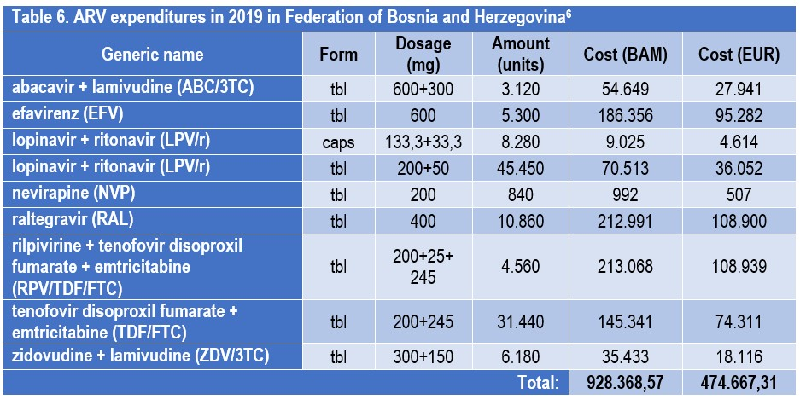
Greatest portion of the ARV cost is related to the 2 newest brand drugs (Isentress®; Eviplera®) and 1 older brand drug (Truvada®).
⁶ Data provided 10/11/2020 e-mail from Health Insurance and Reinsurance Institute of Federation of Bosnia and Herzegovina

Slide 10
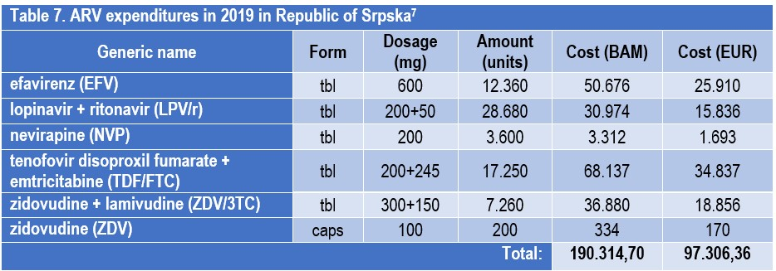
Greatest portion of the ARV cost relates to 1 brand drug (Truvada®).
⁷ Data provided 26/11/2020 e-mail from Health Insurance Fund of Republic of Srpska

Slide 11
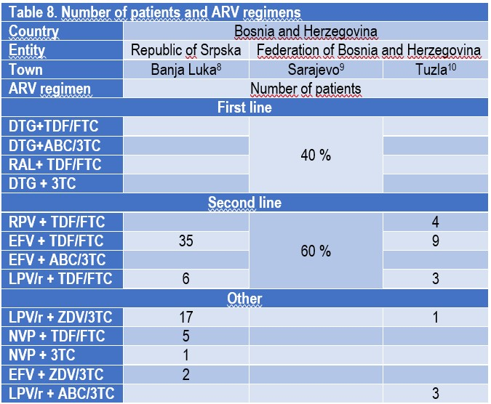
Diversity of ARV regimens used (from older to modern) is due to:
limited availability of medicines
lack of contemporary guidelines
financial constraints
Only 25,64 % patients nation wide are treated with first line regimens
⁸ Data provided 3/12/2020 e-mail from prof. Antonija Verhaz, MD, PhD
⁹ Data provided 8/12/2020 e-mail from Vesna Hadžiosmanović, MD
¹⁰ Data provided 9/12/2020 e-mail from ass. prof. Rahima Jahić, MD, PhD

Slide 12
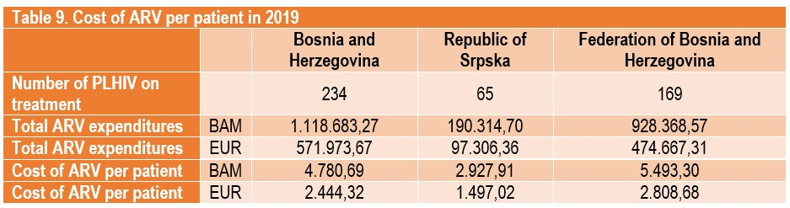
Total ARV expenditures in Bosnia and Herzegovina are significant, although not too high.
The total cost of ARVs significantly differs between the two sources of funding, in total amount and per patient.

Slide 13
THANK YOU FOR YOUR ATTENTION!
Siniša Skočibušić, MD, MSc
ID specialist
sinisa.skocibusic@gmail.com

