Slide 1
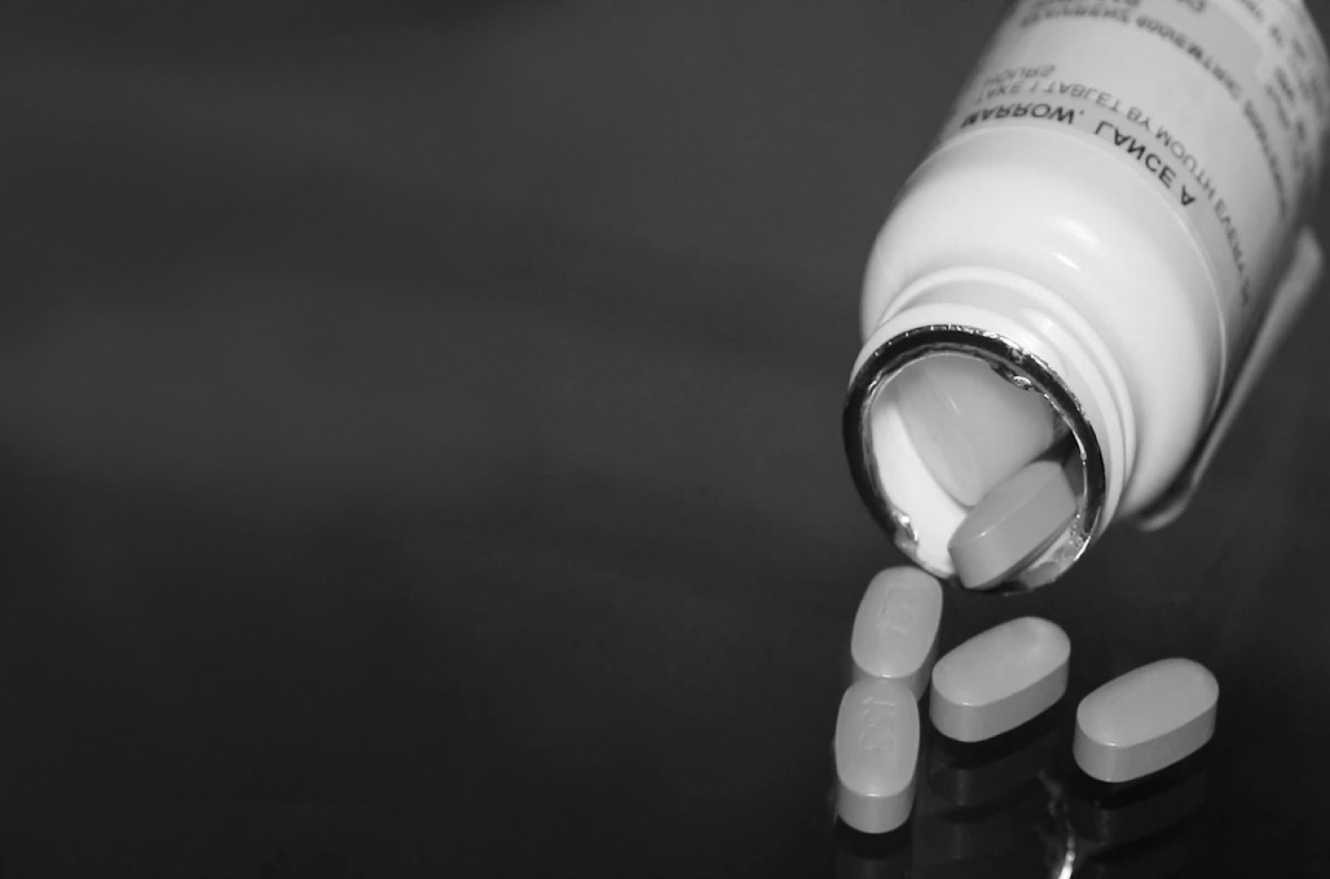
Role of patients in lowering prices in the EECA region
Advocacy tools
December 15, 2020
SERGII DMITRIIEV
Policy and Advocacy Director
CO “100% LIFE”

Slide 2
Advocacy tools
[EECA]
Interaction with international projects aimed at the access to treatment and intellectual property:
МРР
– inclusion of the country in the licensing agreement, entry of new drugs/combinations to the market
ITPC global
– synergetic efforts of the non-governmental sector
UNDP, UNICEF
– entry of new drugs/ combinations to the market; price reduction
WHO
– consultations on treatment optimization and effective ARV medicines

Slide 3
Advocacy tools
[EECA]
Partnership with the public sector:
1
2
3
Working in expert working groups
Working on the formation of the procurement nomenclature, terms of references
Patient control over regimens optimization and procurement process

Slide 4
Advocacy tools
[EECA]
Creation of a competitive environment
Negotiation process with pharmaceutical manufacturers:
technical assistance in the local registration of drugs,
technical assistance in participation in tenders
Participation in regional/international meetings regarding access to treatment
International СAB, European САВ, EECA САВ
Improvement of procurement mechanisms: monitoring, analysis, improvement

Slide 5
OPTIMIZATION METHODS
[EECA]
1
Changing national clinical treatment guidelines according to the WHO recommendations
2
Adoption of a national strategy to optimize treatment
3
Adoption of an order on the ratio of drugs in ART regimens

Slide 6
SERGII DMITRIIEV
CО «100% LIFE»
s.dmitriev@network.org.ua www.network.org.ua

