Slide 1
Use of competition for lowering prices for HIV treatments
Generic: myths and realities
Dr. Alex Schneider

Slide 2
Myths
Generic quality is poor
Generics are ineffective
Generics cause additional side effects
Cheap is bad

Slide 3
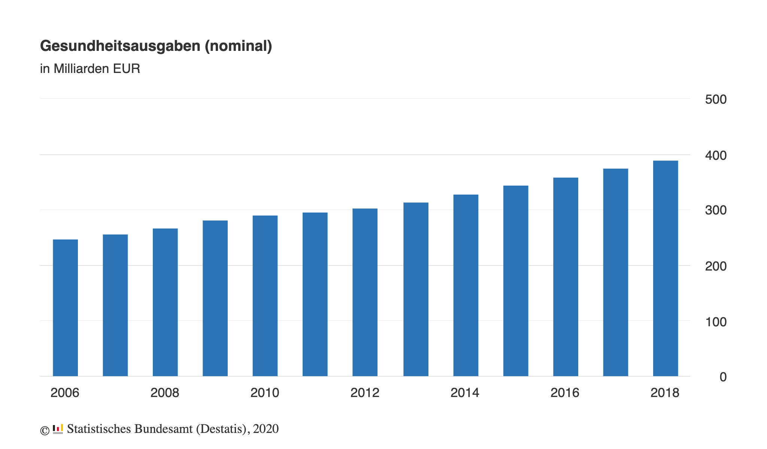
Germany: health care market
Medicines
Volume
Costs

Slide 4
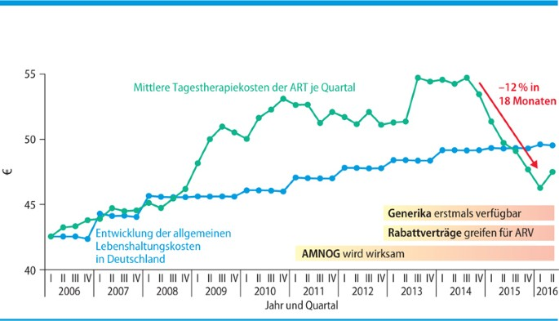
Germany: ART market
TDF/FTC
Germany
Originator 1 supplier | Generic >10 suppliers
797.67 EUR/pck. 26.59/tbl. | 48.79 EUR/pck. 1.63 EUR/tbl.
>16 times
PrEP reimbursement has been possible for everyone
since 2019
MMW Fortschritte der Medizin 2018 . S2 / 160, 37-39
Price drop: NVP – 67%, EFV – 46%, ABC – 20%

Slide 5
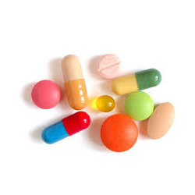
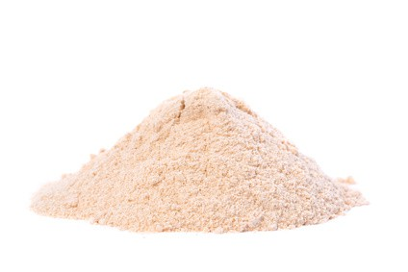
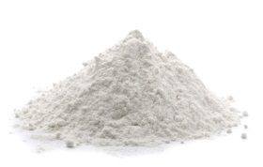
ORIGINATOR
GENERIC
NO GENERIC
Medicine/Drug
API
Finished dosage form
Tablets, solutions, drops, etc.
powder

Slide 6
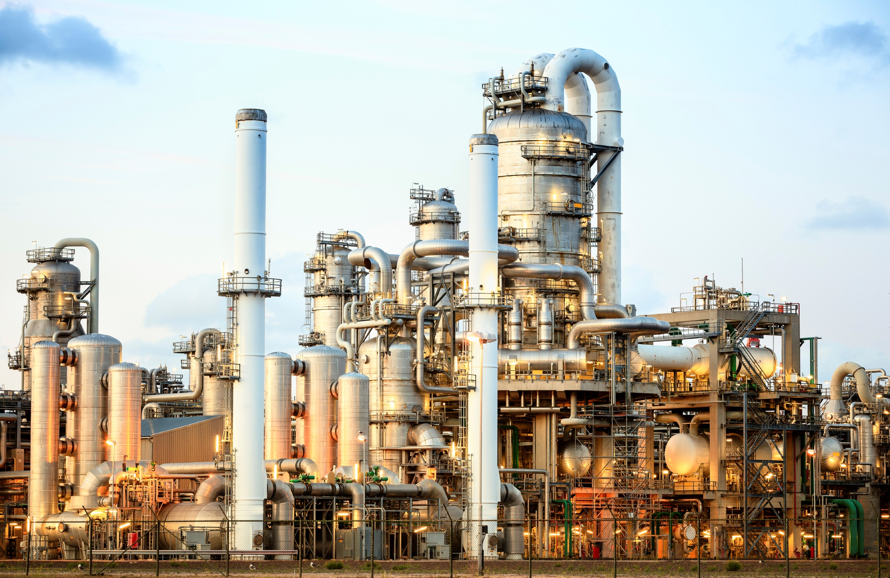
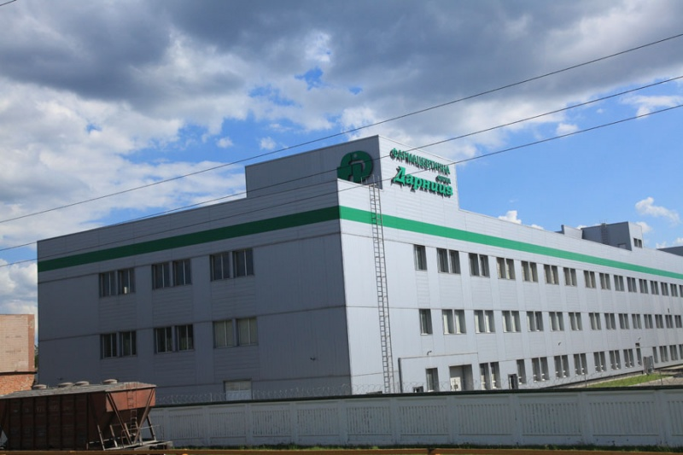
ORIGINATOR
GENERIC
NO GENERIC
Medicine/Drug
Limited sources
API
Finished dosage form
ICH Recommendation (The International Council for Harmonisation of Technical Requirements for Pharmaceuticals for Human Use)
GMP (Good Manufacturing Practice)
WHO prequalification
CHEMICAL PLANT
PHARMA PLANT

Slide 7
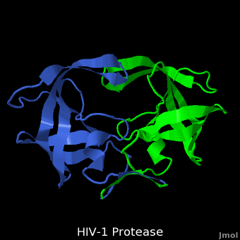
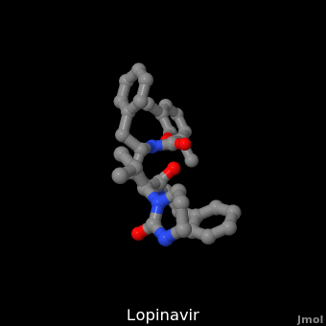
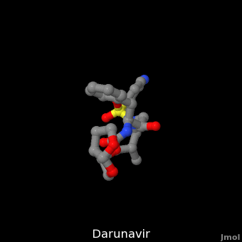
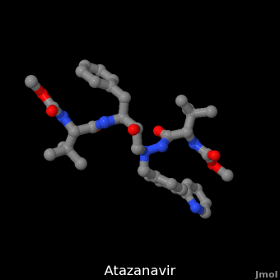
Protease and inhibitors – side effects

Slide 8
Production cost
Tenofovir | Emtricitabine
329 $ / kg (2 000 кг) 6.7 mil. tbl. 18.5k ppl/year | 329 $ / kg (2 000 kg) 10 mil. tbl. 27.8k ppl/year
TDF/FTC
Tenofovir – 300 mg
Emtricitabine – 200 mg
The cost of API per 1 tab – 0.1645 $
The cost of API per 30 tab – 4.935 $
The cost of excipients per 30 tab – 0.1 – 0.2 $
Production of tablets and packaging of 30 tablets – 0.3 – 1.0 $
Production cost of 1 package Truvada – 5.3 – 6.0 $

Slide 9
Thank you very much
for your attention

