Slide 1
Romania RAA, ACCEPT, ARAS, UNOPA
Regional meeting for South Eastern Europe Regional HIV and TB Community Network on the access and prices of the ARV drugs
15 December 2020
(#SOS Project)
Notes:
https://health-observatory.ro/wp-content/uploads/2019/11/The-Romanian-HIV-National-Program_Description-of-a-Maze_Policy-Report.pdf

Slide 2
General info
Significant improvements in the management of HIV/AIDS were registered in Romania in the last decade.
Rate of new HIV diagnosis per 100 000 population was in 2017 lower than the European Union’s average,
HIV/AIDS mortality was higher than the European Union’s but consistently lower than HIV/AIDS mortality in the WHO European Region (around half of new cases are late presenters)
Treatment protocols: background and guidance: EACS guidelines for HIV treatment

Slide 3
Financing of treatment program
In Romania, there are two main authorities which receive and allocate budget for national health programs:
The Ministry of Health, for the public health and prevention programs – the funds flow in from the national state budget.
The National Health Insurance House, for the treatment programs – the main financing source is the social health insurance fund (FNUASS), but also the national state budget. The claw-back tax is returned as funds to the FNUASS
The prevention, monitoring and control program of HIV/AIDS is coordinated by the Ministry of Health, that uses part of the budget for national procurement through public procedures, medicines and rapid tests and ELISA tests.
The MoH also allocates the rest of the budget directly to the hospitals, for their own public acquisitions of necessary medicines and other assets. The funds are assigned for ARV treatment and HIV testing.
The . The NHIH reimburses the costs for the curative treatment of people in hospitals, as well as for their virological & immunological monitoring, through the day-time care.
National Health Insurance House (NHIH) reimburses the costs for the tests and other services that are performed in the hospitals

Slide 4
Who is in charge of public procurement of ARVs?
The Ministry of Health is the central health authority in Romania which, through its specialized departments and expert committees, carries out policies on national health programs and finances some of them (i.e. HIV/AIDS, TB) with the possibility of carry out centralized public procurements.
The specialized departments of the Ministry of Health in charge with the procurement for the HIV national programs are:
the General Directorate for Medical Assistance and Public Health (DGAMSP) and the National Health Program Agency (ANPS), which collaborate and request information from the technical assistance unit (UATM) on the need for tests and ARV medicines.
The UATM obtains information from the County Public Health Directorates, which in turn asks data from the specialized institutions/hospitals implementing the HIV national programme at the local level.

Slide 5
Public Procurement of HIV Medicines in Romania
MoH organize centralized public purchasing for the ARV treatment and public procurement of rapid tests and ELISA tests HIV/AIDS diagnostic.
centralized public procurement of the ARV treatment: MoH signs framework agreements with the suppliers (maximum of 7 suppliers/framework agreement) that participated to the bidding and offered the lowest prices.
public procurement of rapid tests and ELISA tests: MoH signs direct contracts with the suppliers that participated to the bidding and offered the lowest price.
If there is only one producer on the Romanian market for the medicinal product that is intended to be centrally purchased, the Ministry of Health can conduct a direct negotiation with the manufacturer and directly assign the framework contract (negotiation without prior publication
Notes:
Both types of procurements (Figure 2) ensure that the MoH can purchase the needed treatment/diagnosis kits at much lower prices than would have been the case if institutions/hospitals that implement the national HIV programs made purchases on their own

Slide 6
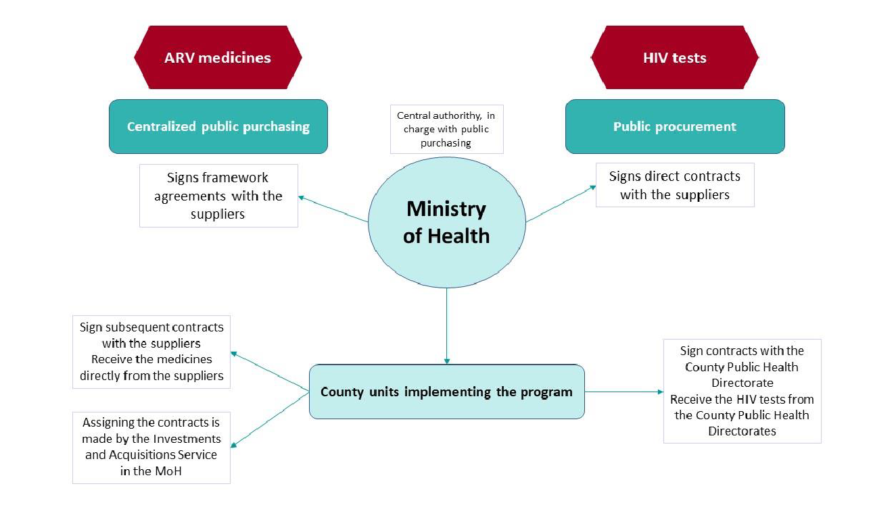

Slide 7
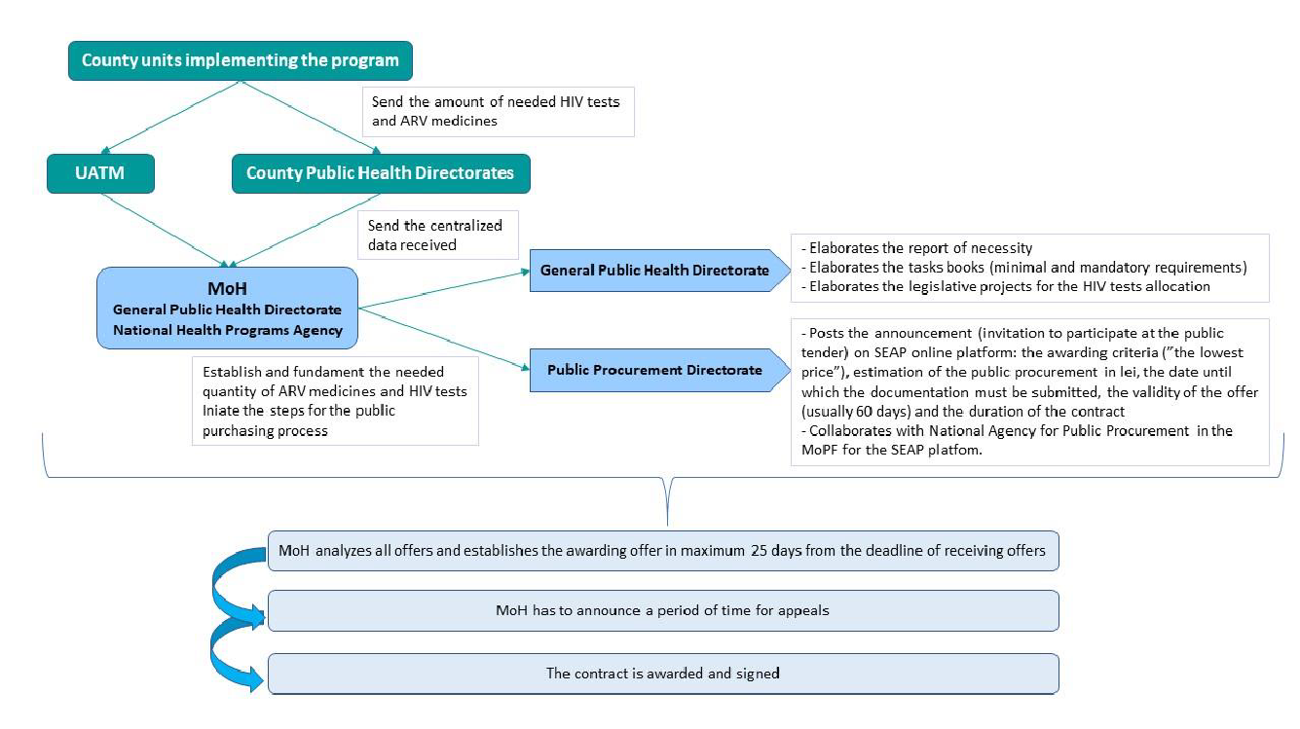

Slide 8
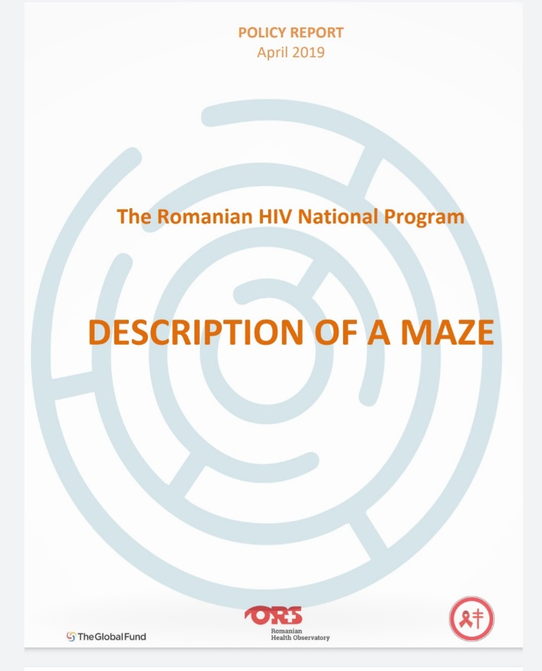
Medicines prices: Princing mechanism in Romania
! Romania, along with the other European Union countries, uses an external reference price mechanism.
! The pharmaceuticals’ price set up in Romania cannot exceed the lowest price in a reference basket formed of 12 countries: Czech Republic, Bulgaria, Hungary, Poland, Slovakia, Austria, Belgium, Italy, Lithuania, Spain, Greece and Germany.
! MoH should perform an annual "correction" of the prices. If files for the revised price is not re-submitted by the market authorization holder, the product’s price will not be listed in the National Medicines Prices Catalogue – CANAMED. If a product is not listed in CANAMED, it will not enter the social reimbursement system and it will not be reimbursed. In the last 10 years this correction was performed twice in 2015 and 2019.

Slide 9
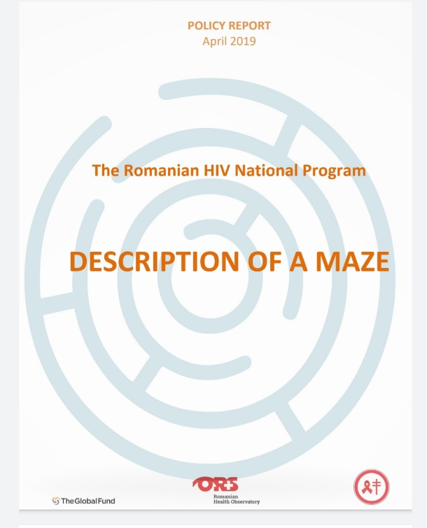
Medicines prices
The Romanian “Anti-retroviral (ARV)” list includes 29 INNs*, out of which are 8 combinations.
A total number of 116 pharmaceutical products of different forms, doses and packages correspond to the 29 INNs.
Prices listed in the CANAMED (the official price catalogue in Romania) for the 116 pharmaceutical products, were analyzed and compared with prices in other four EU member states with populational and epidemiological profiles similar with Romania: Poland, Czech Republic, Hungary and Netherlands.
Source: https://health-observatory.ro/wp-content/uploads/2019/11/The-Romanian-HIV-National-Program_Description-of-a-Maze_Policy-Report.pdf
*INN = International Nonproprietary Name

Slide 10
Medicines prices - Conclusion
Out of 116 pharmaceutical products available in ROMANIA for HIV/AIDS treatment, only 5 have been identified as having a slightly higher price in Romania than in the other European Union countries at the time of the analysis / policy report published in 2019.
https://health-observatory.ro/wp-content/uploads/2019/11/The-Romanian-HIV-National-Program_Description-of-a-Maze_Policy-Report.pdf
Additional rules for generic medicines have been introduced in Romania: the price should not exceed the "generic reference price".
The generic reference price represents 65% of the price of innovative medicine present in the market and this is set only once, usually when approving the price for the first generic medicine on the market.
For biosimilars, the reference price is set up to 80% of the price of the innovative biosimilars on the market.

Slide 11
OPTIMA HIV*: Key Recommendations for Romania in priority order for HIV resource optimization
Scaling up HIV testing and prevention programs targeting people who inject drugs and needle-syringe programs to invest over 40% more of the overall budget from 2019 to 2030 at the latest reported budget level under optimized allocation. Maintaining increased investment should additional budget become available. Since it was estimated that people who inject drugs transmitted 15% of all new HIV infections in Romania in 2018;
Scaling up HIV treatment at the latest reported budget level under optimized allocation, maintaining increased investment up to 125% optimized budget level;
Prioritizing HIV testing and prevention programs targeting female sex workers at 125% optimized budget level and above;
Greatly prioritizing HIV services (mainly for the general population) at 150% optimized budget level and above; and
Prioritizing HIV testing and prevention programs targeting men who have sex with men at 150% optimized budget level and above.
* Source: http://ocds.co/pubs/Romania_2020.pdf

