Slide 1
Antiretroviral (ARV) Drugs Price Optimization in the Republic of Serbia
Goran Radisavljević, TOC
Maja Stosic, MD, PhD on behalf of the consultant team

Slide 2
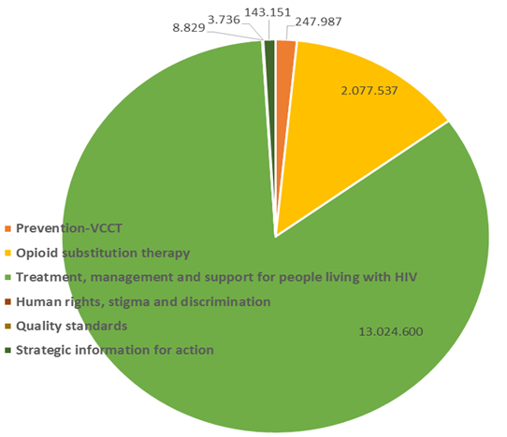
Context of price optimization efforts
3,200 people with HIV lived in Serbia in 2019, out of which 2,800 people were aware of their HIV status.
2,100 people were on ARV therapy.
Total budget allocated for HIV/AIDS prevention and control in 2019 was 1.727.428.408 RSD (16,054,167 USD), while funds allocated by the Ministry of Health (MoH) and National Health Insurance Fund (NHIF) for 2019 was 1.668.428.408 RSD (15,505,840 USD).
Due to the increase of newly infected people in need for a treatment, this budget will increase at the rate of 3% per year in a period 2020-2025.
The majority of MoH and NHIF budget (84%) is allocated for HIV/AIDS treatment, management and support, while only 1.6% for prevention (voluntary confidential HIV counseling and testing).

Slide 3
ARV price as an issue in Serbia
The prices of ARV in Serbia are still very high and comprises significant and therefore, portion of the overall budget for HIV/AIDS.
Branded ARV drugs from lists A, B and C are procured by the National Health Insurance Fund (NHIF) through centralized public procurement procedure,
Unregistered drugs (List D) are procured by designated health institutions in accordance with the Public Procurement Law (Official Gazette of the Republic of Serbia, No. 124/2012, 14/2015 and 68/2015).
Good practices in price reduction strategies established within management of other diseases in Serbia- biological treatments, leucoses (Imatinib- protein tyrosine kinase inhibitor, Glivec®- Anzovip®)

Slide 4
Strategy objectives and key approaches
Price reduction of branded ARVs drugs
Update the list of latest generation of ARVs based on treatment guidelines developed, to be purchased and prices negotiated by the NHIF.
Procurement through international mechanisms
Studies examining patients’ and providers’ knowledge and attitudes to generic substitution in HIV treatment
Capacity building of key stakeholders regarding use of generics.
Presentation of examples of good practice from other countries and good practices in NHIF established within management of other diseases - biological treatments, leucoses (Imatinib- protein tyrosine kinase inhibitor, Glivec®- Anzovip®)
Start a dialogue with the most cost-efficient and effective manufacturers on entering the national markets.
Optimization of ART schemes
Development of National HIV treatment guidelines based on latest EACS guidelines

Slide 5
Process of strategy definition
Identification of widely recognized strategies to reduce ARV prices in low- and middle-income countries as well as combination of strategies.
Situation analysis – ARV drugs procurement processes and practice in the country
Feasibility analysis - meetings and interviews with the relevant stakeholders (Government of Serbia, Ministry of Health, National Health Insurance Fund,International Organizations, clinicians, PLHIV)
Cost analysis - estimation of savings in various scenarios

Slide 6
Implementing partners
Government of Serbia
Ministry of Health
National Health Insurance Fund
Clinicians
International organizations
NGOs
PLHIV

Slide 7
Re-allocation of savings due to price reduction; the options recommended
By using strategies defined, country could create significant annual savings that can be used for prevention program.
With annual reduction of budget for drugs for 20%, the amount of funds for prevention can be doubled within two years.
 | USD per patient per year | Number of patients | USD total funding per year | Savings (USD)
Current | 1241 | 2100 | 2.605.000
Pooled procurement | 930 | 2100 | 1.953.750 | 651.250
Procurement through international mechanisms | 735 | 2100 | 1.543.363 | 1.061.637
Optimized schemes for ART based on the EACS and WHO Guidelines | 1092 | 2100 | 2.292.400 | 312.600
Differential pricing for branded ARVs drugs | n/a | 2100 | n/a | n/a

Slide 8
What is the current status of the implementation of the strategy and what are planned steps for 2021
Government of Serbia officialy confirmed willingness to negotiate regarding ARV price optimization and increasing budget for HIV/AIDS Prevention.
Development of National HIV treatment guidelines based on latest EACS guidelines.
Capacity building of key stakeholders regarding ARV price optimization. Presentation of examples of good practice from other countries and good practices in NHIF established within management of other diseases - biological treatments, leucoses (Imatinib- protein tyrosine kinase inhibitor, Glivec®- Anzovip®).
Start a dialogue with the most cost-efficient and effective manufacturers on entering the national markets.
Update the list of latest generation of ARVs based on treatment guidelines developed, to be purchased and prices negotiated by the NHIF.

