Slide 1
ART optimization opportunities for SEE countries in the context of HIV epidemic in the WHO European Region.
15 December 2020
Dr Elena Vovc
Joint Tuberculosis, HIV and Viral Hepatitis Programme

Slide 2
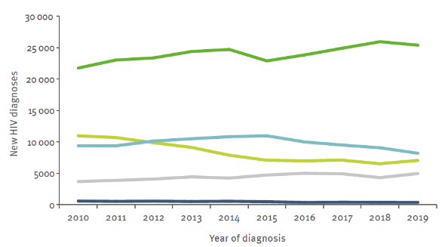
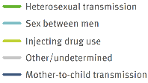
Epidemic trends in the WHO European Region, 2019
New HIV diagnoses, by transmission mode WHO European Region, 2010–2019
Late HIV diagnosis remains a challenge with variation across transmission mode & age
% of PLHIV diagnosed late increases with age and is highest in people over age 50
% of PLHIV diagnosed late is highest among those infected heterosexually (for both, men and women)
Source: ECDC/WHO (2020). HIV/AIDS Surveillance in Europe 2020– 2019 data

Slide 3
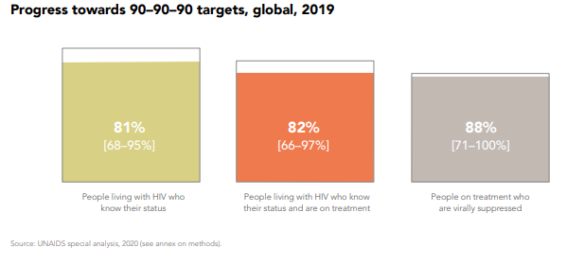
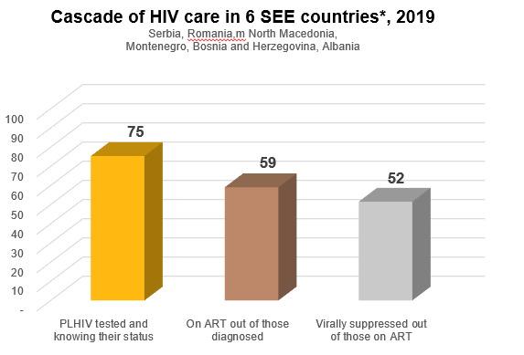
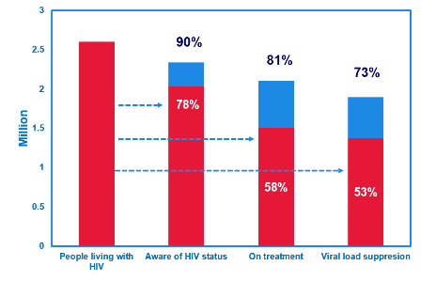
Progress towards 90-90-90
WHO European Region, 2019
Source: UNAIDS/WHO estimates 2019

Slide 4
ART optimization
Harmonization of efforts to accelerate access to simpler, safer, more affordable HIV treatment.
clinical purpose / individual approach – improve treatment outcomes for patients (FDC for better adherence, rational ARV regimen switching, ART monitoring VL, CD4, HIV DR)
public health approach - optimize cost and quality of national ART programmes
Optimal national choice: fewer # of regimens, harmonized ARVs used in 1st, 2nd, 3rd line, use of FDC to prevent non-adherence consequences; adjust procurements of ARVs used as preferred, alternative and special situations; use prequalified ARVs and generics
Optimize procurements - mechanisms to decrease prices for ARVs
HIV treatment must be:
effective, safe, well-tolerated and affordable.
easy-to-use for women of childbearing age, children, key populations, people with TB & other co-infections – groups of significant proportion of PLHIV.
Systematic use of more potent and lower-cost drugs that meet these conditions enable countries to extend lifesaving treatment to a greater number of PLHIV => saved funds to be used to cover the needs of all PLHIV.
Notes:
What Is Antiretroviral Therapy Optimization?
Antiretroviral therapy (ART) optimization is the harmonization of global efforts to accelerate access to simpler, safer and more affordable HIV treatment. To meet the needs of people in low- and middle-income countries, HIV treatment must be effective, safe, well-tolerated and affordable. Treatment must also be easy-to-use for women of childbearing age, children, key populations and people with TB, and other co-infections – groups that make up a significant proportion of people living with HIV. The systematic use of more potent and lower-cost drugs that meet these conditions enable countries to extend lifesaving treatment to a greater number of people living with HIV, which also allows development dollars to stretch even further.

Slide 5
ARV Drug Optimization: Key Principles
Reduce toxicity
Improve palatability/pill burden
Increase resistance barrier
Reduce drug interactions
Safe use across different age groups and populations (“Harmonization”)
Reduce cost
Gallant, 2002

Slide 6
Major Areas for ARV Optimization in HIV Therapy
Major Areas for ARV Optimization | efficacy and safety | simplification | harmonization | cost
Co-formulations | ↔ | ↑ | ↑ or ↔ | ↓
New drug class | ↑ | ↑ or ↔ | ↑ | ↓ or ↑
Dose adjustment | ↑ or ↔ | ↑ | ↑ or ↔ | ↓ or ↑
Drug manufacturing process | ↔ | ↔ | ↔ | ↓
New formulations | ↑ or ↔ | ↑ | ↑ | ↓
New strategies | ↑ or ↔ | ↑ | ↔ | ↓
↑ = increased ↔ = not affected ↓ = decreased

Slide 7
Fixed dose combinations => better adherence, less need to switch for other regimens, less cost for treating advanced complicated cases
Dolutegravir
(DTG) 50 mg
Lamivudine (3TC) 300 mg
Tenofavir (TDF) 300 mg
Fixed dose combination (FDC)

Slide 8
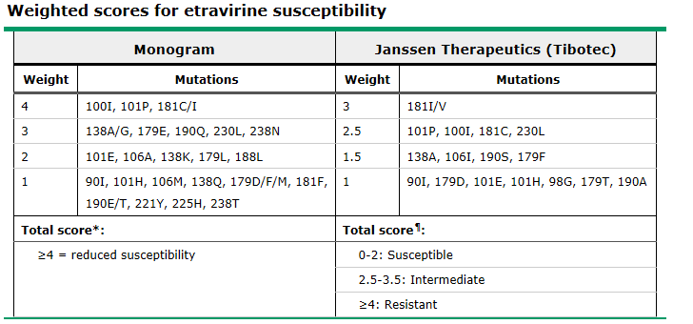
3rd line ART – example (EECA country, 2017)
Product Name | Specification |  | Year 1
 |  | Unit Cost, USD | Quantity | Total, USD
NB! Consider clinical appropriateness for changing regimens
Etravirine | 100mg - Tablet - Bottle of 120 | 300.00 | 528 | 158,400
Replace with Dolutegravir | 50mg - Tablet - Bottle of 30 | 5.00 | 2,112 | 10,560
Notes:
Probably, the clinicians are requesting it as an alternative NNRTI for EFV , because of the concerns in the region about its use in IDU and PW, which is not exactly the most correct approach.
If a patient that needs a change of regimen given a possible suspected HIV DR has more than 3 NNRTI mutations for example, its virologic efficacy will be compromised and ETR should not be used (therefore, a genotyping test is usually needed to better indicate this specific drug). It is really a salvage drug, and even in this context, to take a decision to indicate ETR the doctor would need to have some specific information on previous NNRTI exposure. Usually, the preferred regimen choice of the 3rd line RAL +DRV/r has a better genetic barrier.
On another note, the best approach at national level in a programmatic context would be the transition to Dolutegravir (DTG), which is also now described in the latest technical update by WHO issued in July 2017, that in the context of the countries in EECA would certainly be cost saving.
If current procuremnts of ETR to replace with DTG - the cost for a year will decrease from 158 400 USD to 10 560 USD

Slide 9
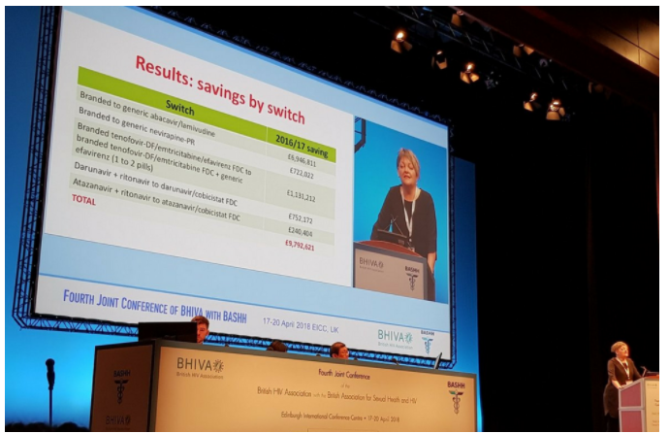
£10 million saved by NHS in England in 2016 by switching to generic anti-HIV drugs
A programme to encourage clinicians to switch people to generic antiretroviral drugs saved the NHS almost £10 million in the financial year 2016-2017,
2/3 of NHS UK spending on HIV medical care is for ARVs (£429 million spent in 2015-2016).
↑ # of PLHIV needing lifelong ART => the budget for ARVs was expected to continue growing in case of inaction
Across UK (NHS), around 70% of drugs prescribed are produced by generic manufacturers. They have the same active ingredients as branded drugs but are cheaper.
https://www.aidsmap.com/news
Laura Waters presenting at the 2018 BHIVA/BASHH conference. Image credit: @hivtc
Notes:
A programme to encourage clinicians to switch people to generic antiretroviral drugs saved the NHS almost £10 million in the financial year 2016-2017, Dr Laura Waters of NHS England’s Clinical Reference Group for HIV services told the recent joint British HIV Association (BHIVA) and British Association for Sexual Health and HIV (BASHH) conference in Edinburgh
Around two-thirds of NHS England’s spending on HIV medical care is for antiretroviral drugs, with £429 million spent in 2015-2016. Because of the increasing number of people needing lifelong treatment, the drugs budget would continue to grow if action were not taken.
Across the NHS, around 70% of drugs prescribed are produced by generic manufacturers. They have the same active ingredients as branded drugs but are cheaper.

Slide 10
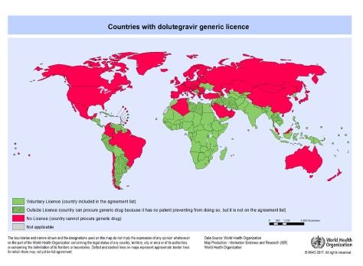
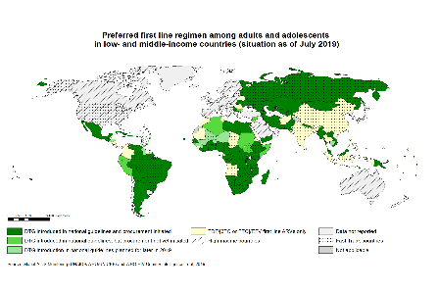
Licensing and pricing of DTG in LMICs
Country | DTG U$ price (pppy), 2016/17
LMICs (generic) | 48 - 60
LMICs (originator) | 396 - 1740
Botswana | 272
Brazil | 547
Mexico | 2200
Belarus | 2300
Ukraine | 72
Sources: MSF, GFTAM, CHAI, MoH Brazil , Botswana, Mexico & Ukraine
TDF/3TC/DTG in 92 LMICs = 75 U$ pppy (Sep/2017)

Slide 11
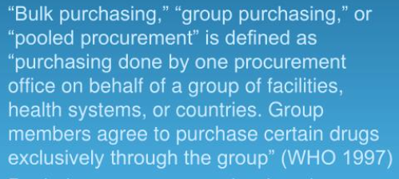
Decrease ARVs prices …
Traditional procurement methods
Alternative: Pooled procurement
Non transparency, weak bargaining power/high prices, corruption, inefficiencies, delay and high transaction costs, stock outs
Increased price transparence to access lowest price supplier and negotiating price reduction.
Need to standardize treatment approaches, adjust legislation and reach intercountry agreements.
PROCUREMENT & SUPPLY: POOLED PROCUREMENT. UKZN IP & Access to Medicines 2009 Professor Brook K. Baker Northeastern U. School of Law Health GAP (Global Access Project) b.baker@neu.edu.

Slide 13
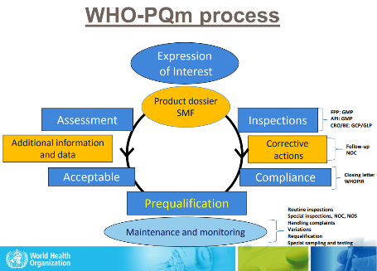
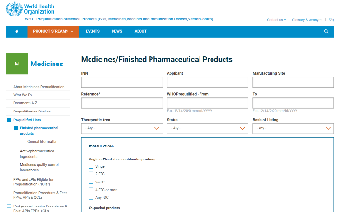
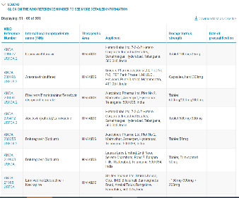
https://extranet.who.int/pqweb/

Slide 14
First-line ART in guidelines
WHO^{[1]} | IAS-USA^{[2]} | EACS^{[3]} | DHHS^{[4]}
Preferred First-line Regimen DTG + 3TC(FTC)+ TDF Alternative EFV400+3TC(FTC)+ TDF | Generally Recommended Initial Regimens BIC/FTC/TAF DTG/ABC/3TC DTG + FTC/TAF | Recommended Regimens (Preferred) BIC/FTC/TAF DTG/ABC/3TC DTG + FTC/TAF or XTC/TDF RAL + FTC/TAF or XTC/TDF Recommended Regimens DOR + FTC/TAF or XTC/TDF DRV + (COBI or RTV) + (FTC/TAF or XTC/TDF) DTG + 3TC RPV + FTC/TAF or XTC/TDF | Recommended Initial Regimens for Most PWH BIC/FTC/TAF DTG/3TC* DTG/ABC/3TC DTG + XTC + (TAF or TDF) RAL + XTC + (TAF or TDF)
*Except when HIV RNA > 500,000 copies/mL, HBV coinfected, or ART to be started before RT genotypic resistance testing or HBV testing results available.
1. WHO Policy Brief. July 2019. 2. Saag. JAMA. 2018;320:379.
3. EACS Guidelines. November 2019. 4. DHHS Guidelines. December 2019
Table adapted from CCO.
Notes:
3TC, lamivudine; ABC, abacavir; BIC, bictegravir; COBI, cobicistat; DOR, doravirine; DRV, darunavir; DTG, dolutegravir; FTC, emtricitabine; HBV, hepatitis B virus; PWH, people with HIV; RAL, raltegravir; RPV, rilpivirine; RT, reverse transcriptase; RTV, ritonavir; TAF, tenofovir alafenamide; TDF, tenofovir disoproxil fumarate; XTC, emtricitabine or lamivudine.

Slide 16
DTG and PIs (LPVr) in 2nd line ART
Safety and Efficacy of ARVs (PICO 2 and 3) (summary 2019 WHO Sys Review & NMA)
EFV₄₀₀ and EFV₆₀₀ in 1st line ART
major outcomes | EFV₄₀₀ vs EFV₆₀₀ | _{quality of evidence}
Treatment discontinuation (due AEs) | EFV400 better | high to moderate
Viral suppression (48-96 weeks), VL suppression if baseline > 100,000 (48 weeks) | comparable | moderate
CD4 recovery (24-96 weeks) | comparable | moderate
Mortality | comparable | low
Neuropsychiatric AEs (any grade), depression (grade 3 or 4), dizziness (any grade), sleep disorders (any grade) | comparable | low to very low
Body weight gain | comparable | low
Treatment related adverse events | EFV400 better | moderate
HIVDR (overall, NRTI or anchor drug) | comparable | very low
major outcomes | DTG vs LPVr | quality of evidence
Treatment discontinuation (any or due AEs) | DTG probably better | high
Viral suppression (4-96 weeks) | DTG better | high
Viral suppression baseline VL > 100,000 (48 weeks) | comparable | moderate
CD4 recovery (24-48 weeks) | comparable | moderate
Mortality | comparable | low
Neuropsychiatric AEs (any grade) | comparable | low
Treatment related SAE | comparable | low
Treatment emergent AE, related AEs | DTG probably better | high
HIVDR ( overall) | comparable | very low
Efficacy outcomes
Tolerability, safety & resistance outcomes
Reference: Steve Kanters, For WHO ARV GDG, 5-7 June 2019
Notes:
Evidence: The NMA showed that DTG, was superior to EFV in terms of viral suppression, CD4 recovery and treatment discontinuation. EFV400 was better than EFV 600 in terms of CD4 recovery and treatment discontinuation, but comparable in terms of viral supression. DTG was betetr than EFV400 in terms of viral suppression and treatment discontinuation. All regimens were comparable in terms of mortality, disease progression and occurrence of SAE. The quality for this evidence was rated according GRADE methodology.
Research gaps: There are concerns on NTD potential risk with DTG if used in the early pregnancy and during the preconception period.

Slide 17
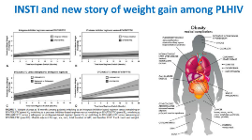
ADVANCE: Mean Change in Weight by Sex at Wk 96 Phase III Trial of First-line DTG + FTC/(TAF or TDF) vs EFV/FTC/TDF in South Africa
Significantly greater weight increase with DTG vs EFV, with TAF vs TDF at Wk 96; plateauing in weight gain after Wk 48 observed in men but not in women
DTG + FTC/TAF (n = 351)
DTG + FTC/TDF (n = 351)
EFV + FTC/TDF (n = 351)
Men
Women
14
14
12
12
10
10
+10 kg
8
8
P < .001
Mean Weight Change (kg)
Mean Weight Change (kg)
6
6
P < .001
+5 kg
+5 kg
4
+4 kg
NS
4
+3 kg
P < .05
2
P < .01
2
P < .01
+1 kg
0
0
0
4
12
24
36
48
60
72
84
96
0
4
12
24
36
48
60
72
84
96
Wk
Wk
n =
430
418
402
387
376
374
366
292
232
140
n =
549
531
514
488
474
459
441
359
276
175
Hill. IAS 2019. Abstr MOAX0102LB.
Slide credit: CCO
Notes:
DTG, dolutegravir; EFV, efavirenz; FTC, emtricitabine; NS, not significant; TAF, tenofovir alafenamide; TDF, tenofovir disoproxil fumarate.

Slide 18
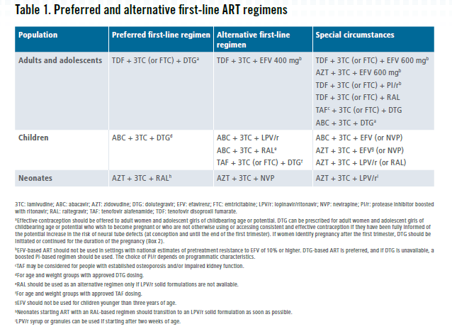
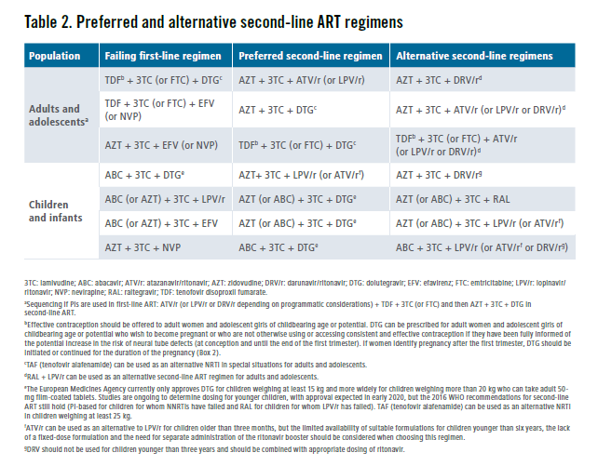
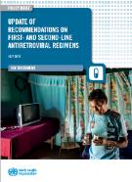
ART regimens, WHO guidelines 2019
WHO recommends genotyping only in 3rd line ART with treatment optimization purpose.
Countries should also implement once in 3 years surveys on PDR and ADR to monitor HIV DR
3rd line regimens
DRV/r^{а} + DTG + 1-2 NRTIs
а) for PLHIV on ART with experinec of receiving Ips the recommended dose of DRV/r should be 600 mg/100 mg 2 times per day.
Notes:
TLD as preferred regimen in 1st line ART for all PLHIV (with approved DTG dose)
TLE400 as alternative 1st line option. TLE600 in special circumstances
Transition то TLD of stable patients using suboptimal regimens is recommended and those on TLE with supressed VL should be considered
DTG regimens as preferred option in 2nd line ART in those who not used DTG in 1st line
Boosted PI as preferred option in those who already used DTG in 1st line
DTG BD in TB/HIV patients using rifampicin is safe
DRV/r as anchor drug in 3rd line, associated with DTG BD (± 1-2 NRTIs as optional)

Slide 19
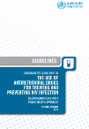
New consolidated HIV guidelines (ART)
KEY HIV GUIDELINES UPDATE ACTIVITIES | PLANNED TIMELINES
Update of clinical recommendations (use of PoC EID&ВН, update of ВН algorithm, use of Dapivirine vaginal ring and timing of ART initiation in TB/HIV coinfection) | Virtual GDG meeting (28 September-02 October 2020)
Update of recommendations on service delivery (frequency of clinical visits & ART dispensing; approaches for reengagement to care, approaches for measure adherence, specimen collection by lay providers; diagnostic integration across HIV, TB Hep and STIs; integration of HIV/NCD care; integration of HIV/family programme; psychosocial interventions for adolescents with HIV, TB/HIV treatment linkage interventions) | Virtual GDG meeting (05-09 October 2020)
Peer review of new clinical and service delivery recommendations and text | October-November 2020
Submit new recommendations to WHO Guidelines Review Commitee (GRC) | mid-December 2020
Update of the narrative text, tables, annexes and references of 2016 guidelines and inclusion of previously approved 2018/2019 recommendations (i.e., update of 2016 guidelines' chapters on HIV diagnosis, prevention, ART, management of comorbidities & coinfections, SD and M&E) | October 2020 – December 2020
GRC approval of updated 2020 clinical and service delivery recommendations | mid-January 2021
Consolidation of all HIV recommendations (i.e., final copy editing, layout and executive clearance for publication of the updated version of Consolidated HIV guidelines) | January – early February 2021
Release of a updated Consolidated HIV Guidelines | Q1 2021 (TBD)
Sep 2020
Q1 2021

Slide 20
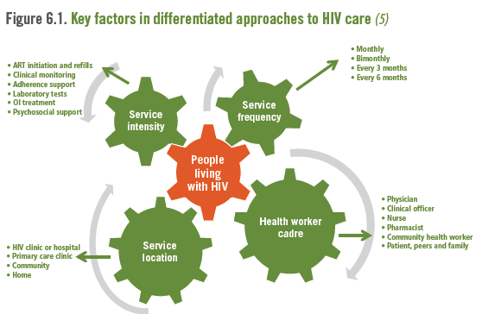
Differentiated HIV care (ART and Tx monitoring provisions) - more feasible for countries in the WHO European Region given recent lessons learnt from the times of the COVID-19 pandemic ? …

Slide 21
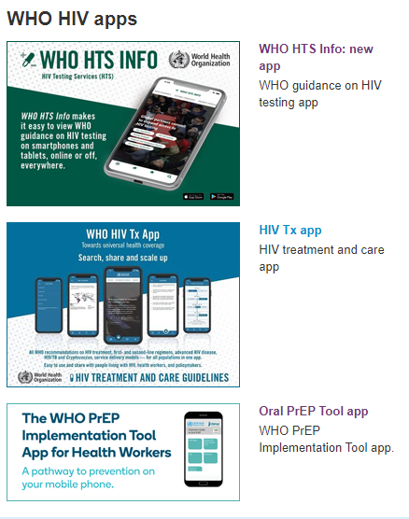
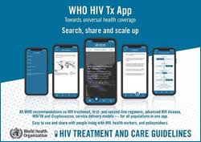
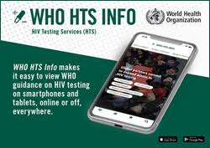
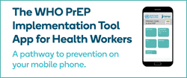
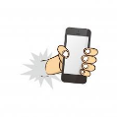
Test, treat and prevent HIV.
Leave no one behind.
Test early, use quality tests: confirm diagnosis in 14 days and link PLHIV to care
Treat timely and effectively: start ART once diagnosed & no later than 7 days from confirmation of diagnosis, reach viral suppression; use optimal regimens and generics.
Prevent always: use effective combination prevention, reach out to key populations
Know and monitor your epidemic.
Have the policies in place.
Use WHO guidelines
e-versions now in your hand !
https://www.who.int/teams/global-hiv-hepatitis-and-stis-programmes

Slide 22
Acknowledgements: Member States, partners, donors, communities affected, WHO headquarters, country offices and JTH team in EURO
WHO Regional Office for Europe
UN City Marmorvej 51 Copenhagen Ø Denmark
WHO_Europe facebook.com/WHOEurope instagram.com/whoeurope youtube.com/user/whoeuro
Joint Tuberculosis, HIV and Viral Hepatitis Programme

Slide 24
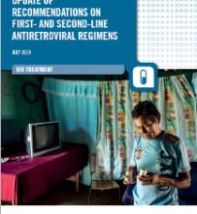
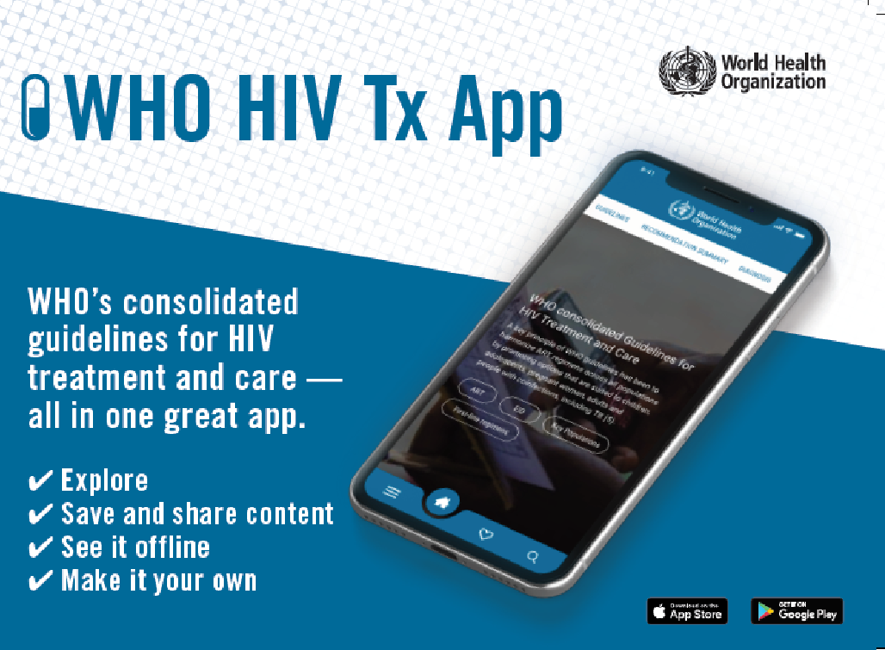
ARV use (adults and adolescents) 2019 WHO recommendations at a glance
TLD as preferred regimen in 1st line ART for all PLHIV (with approved DTG dose)
TLE400 as alternative 1st line option. TLE600 in special circumstances
Transition то TLD of stable patients using suboptimal regimens is recommended and those on TLE with supressed VL should be considered
DTG regimens as preferred option in 2nd line ART in those who not used DTG in 1st line
Boosted PI as preferred option in those who already used DTG in 1st line
DTG BD in TB/HIV patients using rifampicin is safe
DRV/r as anchor drug in 3rd line, associated with DTG BD (± 1-2 NRTIs as optional)
↑
Available on App

Slide 25
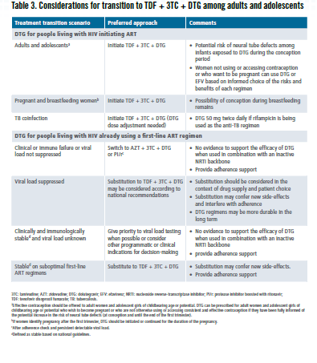

Slide 26
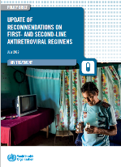
Transition to optimal regimens (children)
Current regimen | Weight | Optimal regimen for transition | Considerations
AZT/3TC/NVP AZT/3TC/EFV ABC/3TC/NVP | <20 kg | ABC/3TC/LPVr | If still stable these can be transitioned to DTG when they reach 20 kg
 | 20-30kg | ABC/3TC/DTG | If still stable these can be transitioned to TLD when they reach 30 kg
 | > 30kg | TLD | -
ABC/3TC/EFV | <20 kg | No change until reach 20 kg unless treatment failure occurs | Of value once reached 20 kg when DTG can be used so that OD administration is preserved.
 | 20-30kg | ABC/3TC/DTG | If still stable these can be transitioned to TLD when they reach 30 kg
 | > 30kg | TLD
ABC/3TC/LPVr AZT/3TC/LPVr | <20 kg | No change until reach 20 kg unless treatment failure occurs | Important to ensure use of tablets as soon as possible to reduce pill burden. Transition from AZT/3TC/LPVr to ABC/3TC/LPVr can also be considered to reduce pill burden
 | 20-30kg | ABC/3TC/DTG | If still stable these can be transitioned to TLD when they reach 30 kg
 | > 30kg | TLD | -
Goal of transition
Improve outcomes
Harmonization
Simplification
Supply security
Children eligible for transition
Already on ART
Clinically stable (defined as per national guidelines)
Prioritize children on NNRTI based regimen

Slide 27
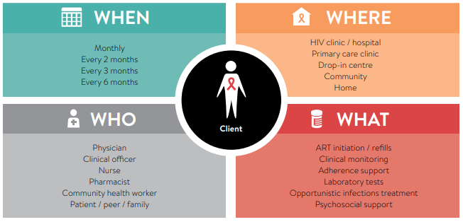
Differentiated approach to care and services
A public health approach that maximizes the benefit for PLHIV and for the health care system
One size does not fit all HIV programmes in all countries
Early
Adherence & retention support
Advanced
Minimal clinical package to reduce illness and death
Stable
Simplified ART delivery- Differentiated Care Models
Unstable
Adherence support vs Switching

